Slide 1



Deploying a Website using EC2 Instance
CHEEKATLA SREERAM
12215613

Slide 2
About project
I'm excited to share my experience of deploying a website using an EC2 instance on AWS as part of my internship at Gokboru Pvt Ltd.
AWS, or Amazon Web Services, is a cloud computing platform that offers a vast array of services, including compute power, storage, and databases. One of its core services is EC2, which provides virtual servers, or instances, in the cloud. By leveraging EC2, we can efficiently deploy and manage websites without the need for physical hardware.
During my internship, I had the opportunity to dive into the process of deploying a website on an EC2 instance. This involved selecting an appropriate instance type based on website traffic and resource requirements, setting up security groups to protect the instance, and installing a web server like Apache or Nginx. Subsequently, I configured the web server to serve the website files, ensuring optimal performance and security.

Slide 3
Steps to implement
Step 1: Create an EC2 Instance
Select an operating system (e.g., Ubuntu, Amazon Linux) that suits your website's requirements.
Determine the appropriate instance type based on your website's expected traffic, CPU, memory, and storage needs.
Create a security group to define inbound and outbound traffic rules for your instance. Allow HTTP (port 80) and HTTPS (port 443) traffic for web access.
Generate a key pair to securely access your instance.
Step 2: Connect to the EC2 Instance
Establish a secure SSH connection to your instance using the key pair you created and a SSH client like PuTTY or the AWS Management Console.

Slide 4
Steps to implement
Step 3: Install Web Server
Update the package lists of your operating system using commands like sudo apt update (Debian/Ubuntu) or sudo yum update (Amazon Linux).
Choose a web server like Apache or Nginx based on your preferences. Use package managers to install them (e.g., sudo apt install apache2 or sudo yum install httpd).
Step 4: Install httpd in terminal
It will helps you to make html to HTTPd, the Apache HTTP Server, is a versatile web server that can be a valuable asset in a wide range of projects
Step 5: Checking the website through IP address
Once your website is deployed on the EC2 instance and configured correctly, you can access it by opening a web browser and entering the public IP address or DNS name of your EC2 instance in the address bar.

Slide 5
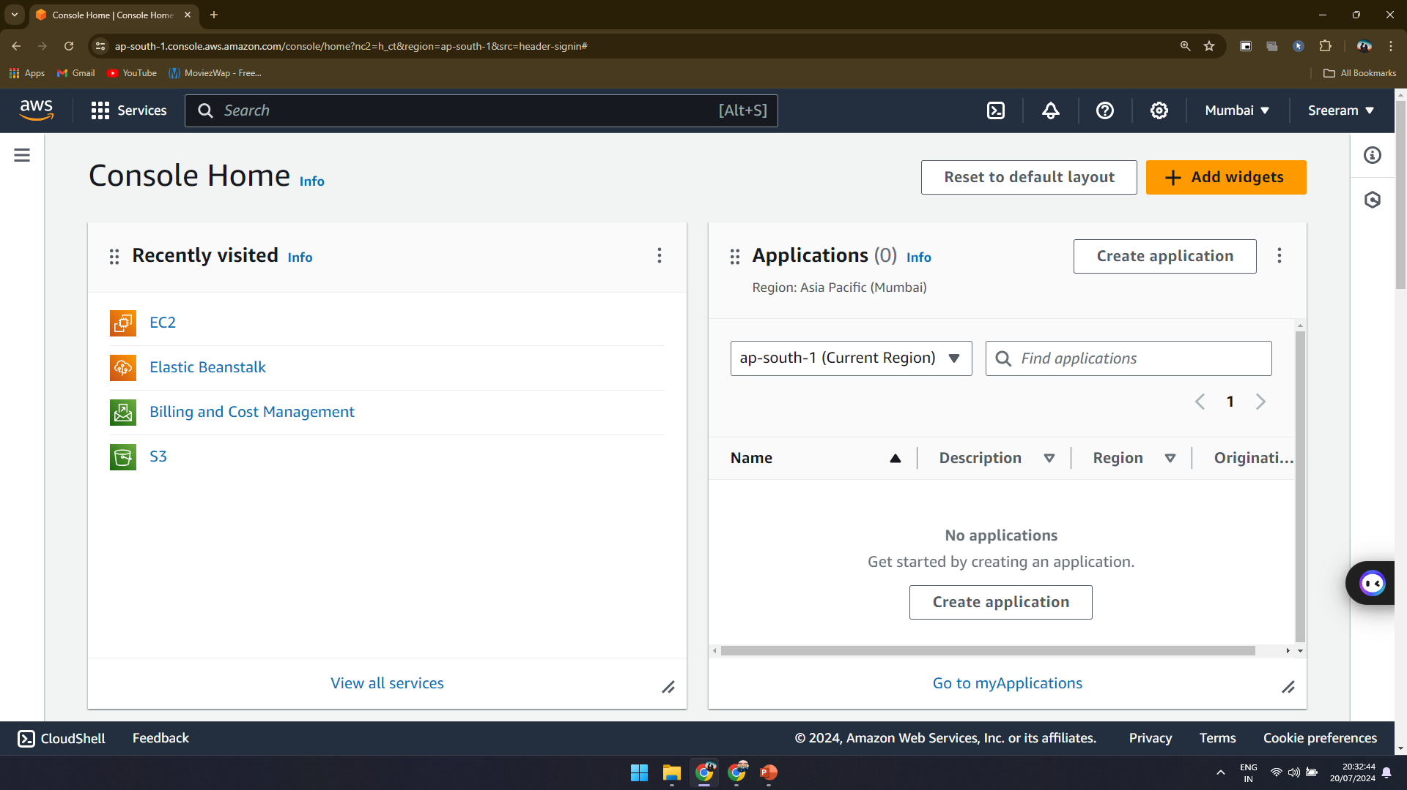

Slide 6
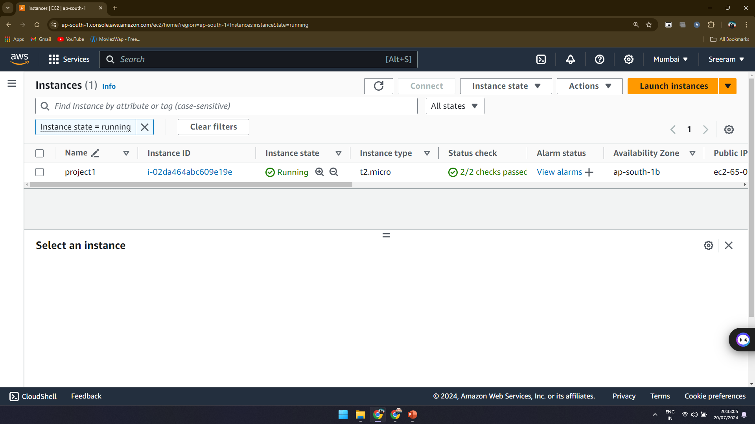

Slide 7
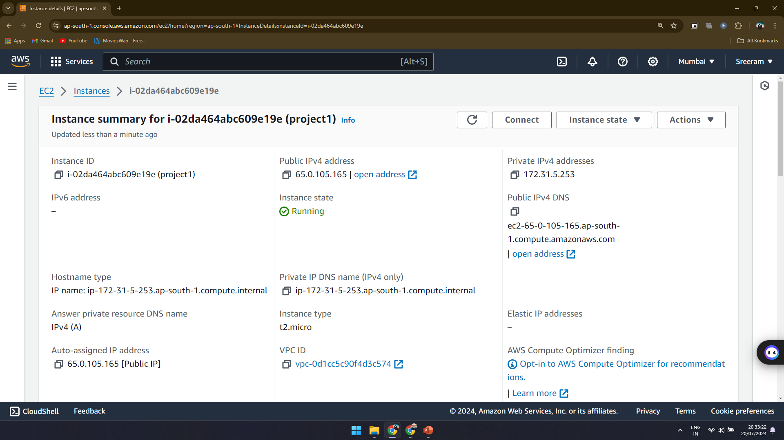

Slide 8
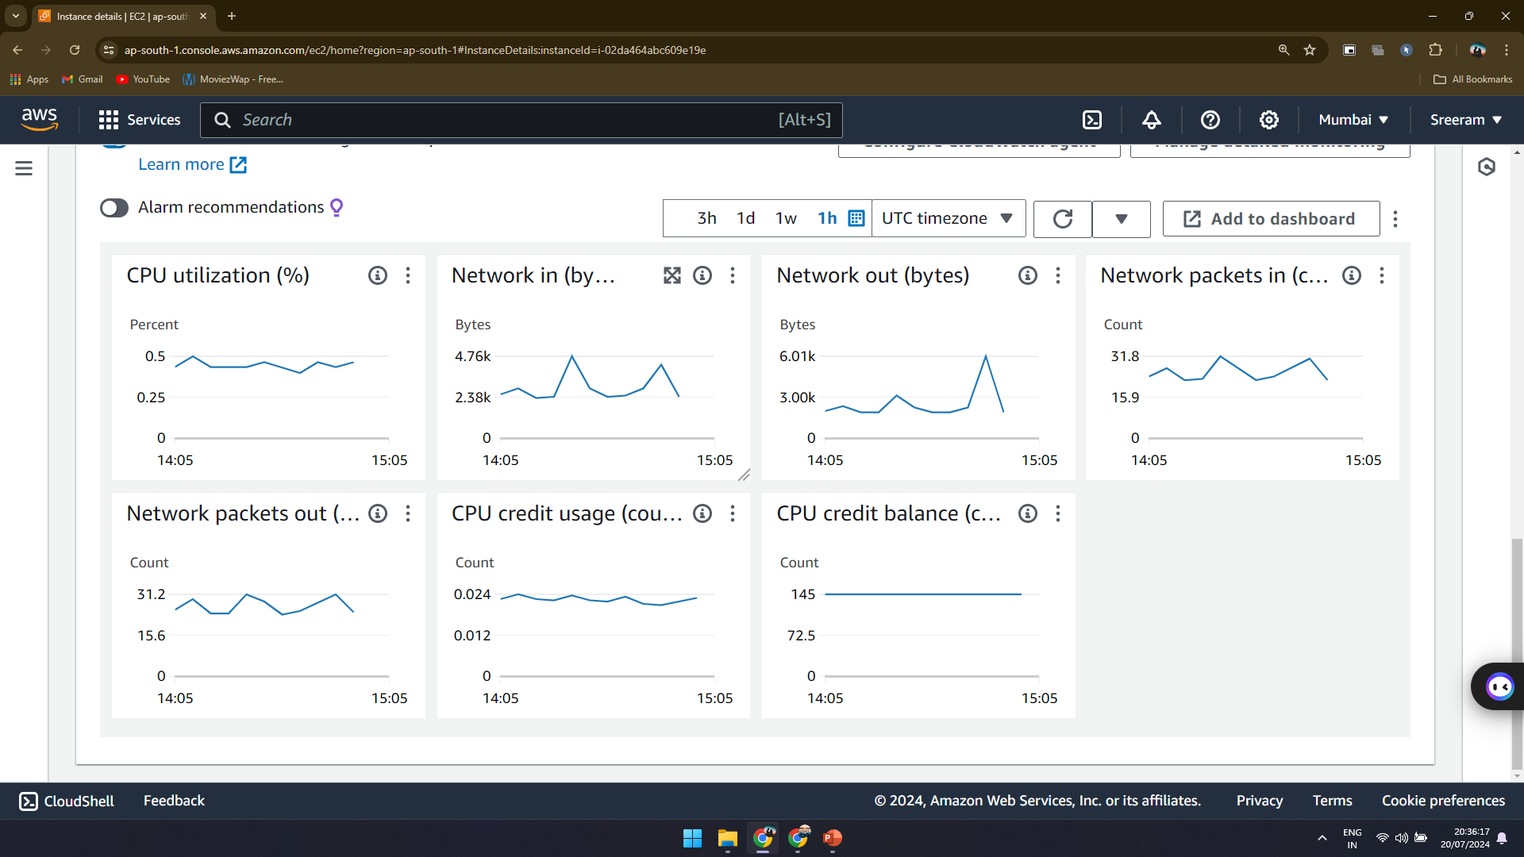

Slide 9
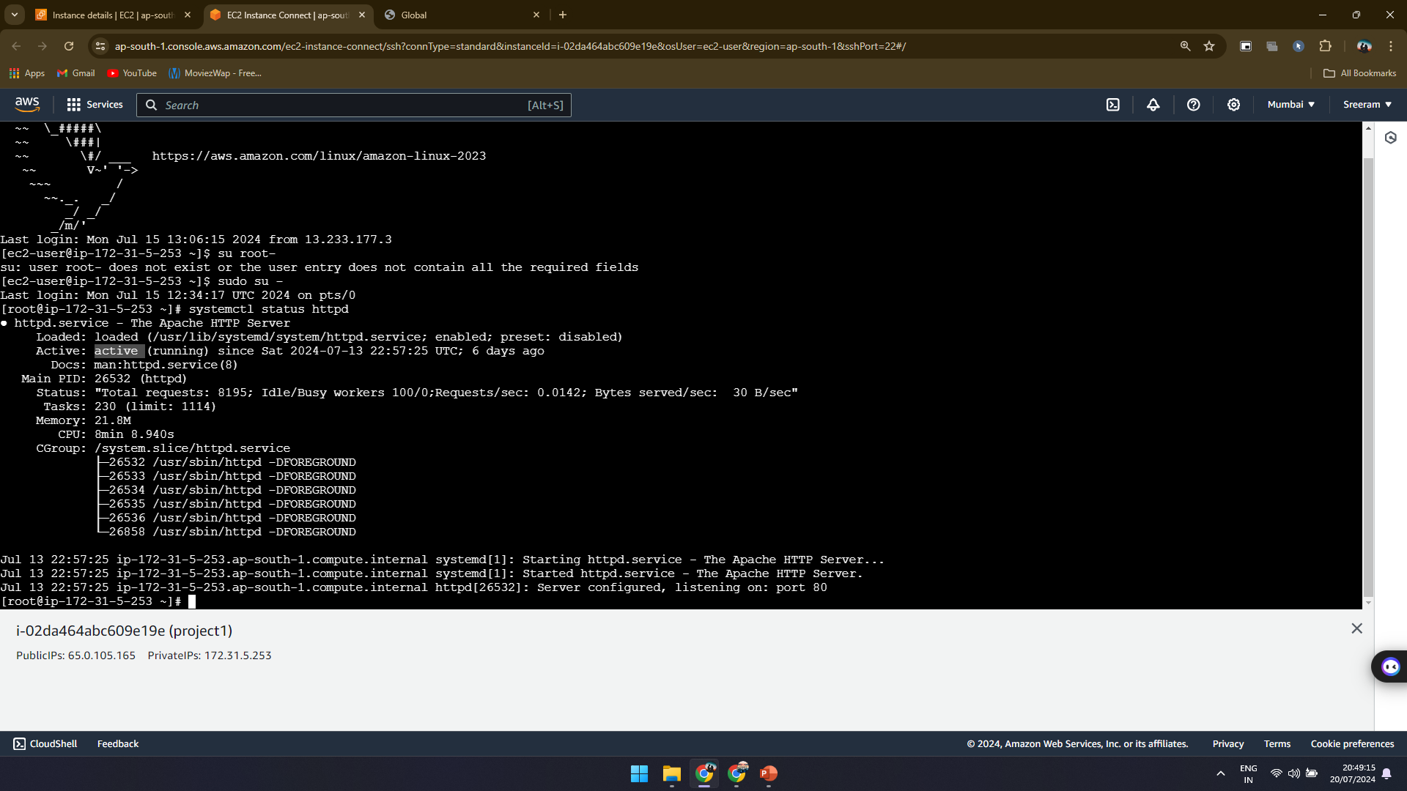

Slide 10


Slide 11
